Slide 1
GeoHumanities’19
3rd ACM SIGSPATIAL Workshop on Geospatial Humanities
5th Nov. 2019 – Holiday Inn at the Mart Plaza, Chicago, Illinois, USA
Opening Remarks – Bruno Martins and Ludovic Moncla

Slide 2
Organizers
http://bgmartins.github.io/sigspatial-geohumanities/

Slide 3
http://bgmartins.github.io/sigspatial-geohumanities/

Slide 4
GeoHumanities’19
Workshop concerned with the use of geographic information systems and other spatial technologies in humanities research
We received 8 submissions, of which we accepted 6 papers for presentation at the workshop
Program Committee with 30 researchers (different backgrounds)
Workshop program contains 2 technical sessions
coffee breaks in between sessions + lunch after the 2nd session
discussion session at the end
Details on the website - http://bgmartins.github.io/sigspatial-geohumanities/

Slide 5
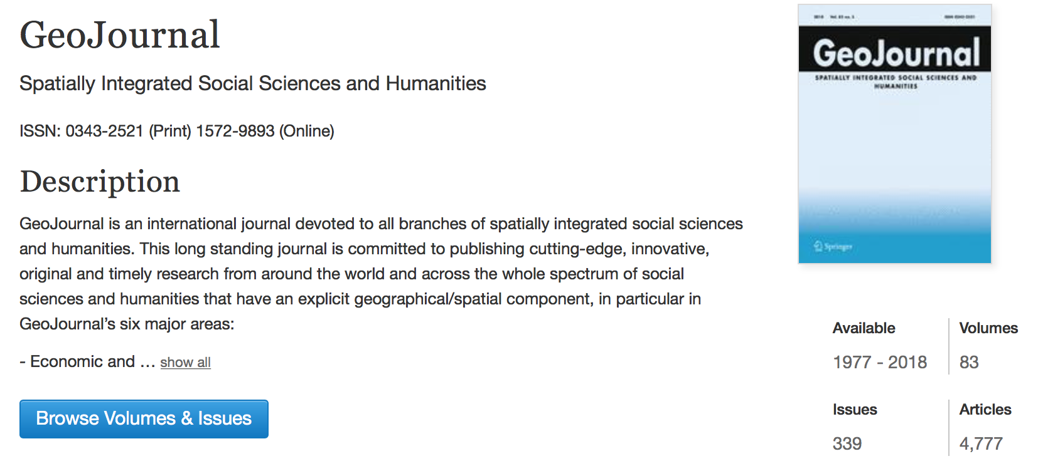
Special Issue at GeoJournal

Slide 6
Session 1
09:15 - 09:40 - Mawo Kamakura, Hikaru Ikuta, Bo Zheng, Yoshihiro Sato, Masataka Kagesawa, Takeshi Oishi, Kaoru Sezaki, Takeshi Nakagawa and Katsushi Ikeuchi.
Preah Vihear Project: Obtaining 3D point-cloud data and its application to spatial distribution analysis of Khmer temples
09:40 - 10:05 - Xiao Huang, Cuizhen Wang and Zhenlong Li.
High-Resolution Population Grid in the CONUS Using Microsoft Building Footprints: A Feasibility Study
10:05 - 10:30 - Rachel Palumbo, Laura Thompson and Gautam Thakur.
SONET: A Semantic Ontological Network Graph for Managing Points of Interest Data Hetereogeneity

Slide 7
Session 2
11:00 - 11:25 - Clio Andris, Brynne Godfrey, Carleen Maitland and Matthew McGee.
The Built Environment and Syrian Refugee Integration in Turkey: An Analysis of Mobile Phone Data
11:25 - 11:50 - Ludovic Moncla, Katherine McDonough, Denis Vigier, Thierry Joliveau and Alice Brenon.
Toponym disambiguation in historical documents using network analysis of qualitative relationships
11:50 - 12:15 - Jimin Wang and Yingjie Hu.
Are We There Yet? Evaluating State-of-the-Art Deep Learning Geoparsers Using EUPEG as a Benchmarking Platform

Slide 8
GeoHumanities’19
Proceedings of the 3rd ACM SIGSPATIAL Workshop on Geospatial Humanities will soon be available from ACM Digital Library

